Slide 1
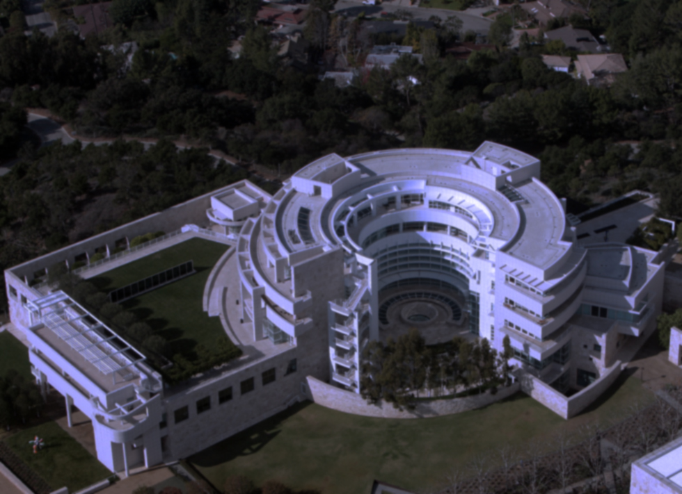
Getty Research Portal Reboot:
Angular & Elasticsearch
for Metadata Search Aggregation

Slide 2

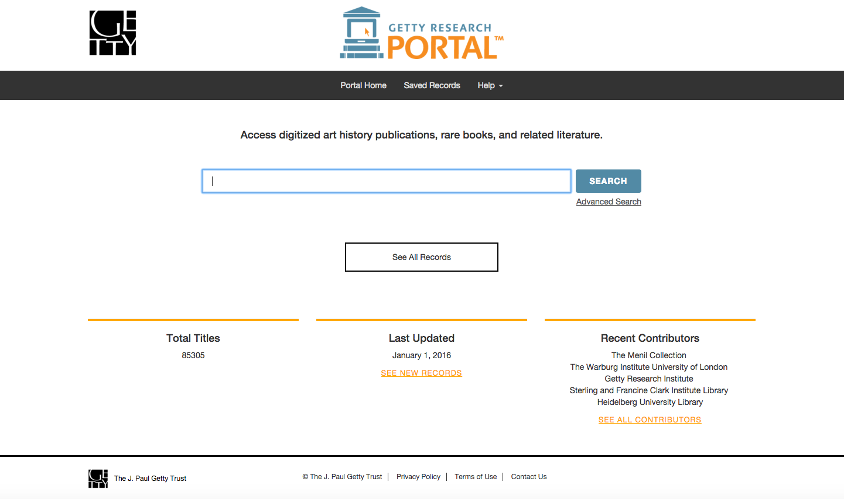
What is the Portal?

Slide 3




What is the Portal?
Authoritative
Everyone likes free stuff.

Slide 4

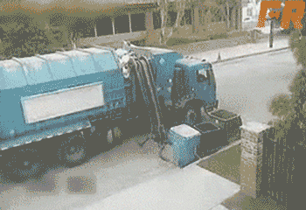
Why throw it in the trash and begin from scratch?

Slide 5

Maintainability

Slide 6


Limited documentation = frustration

Slide 7

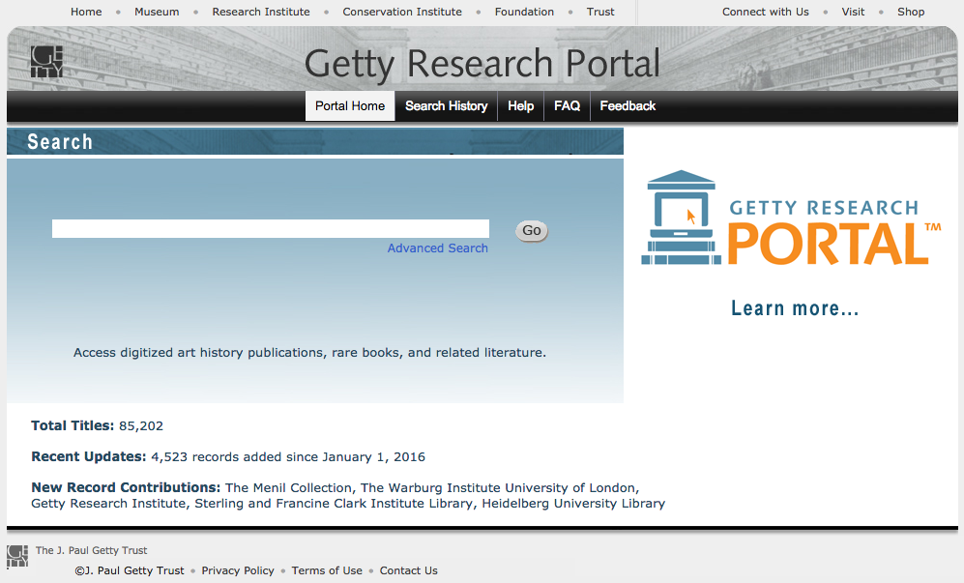
Responsive
Design

Slide 8

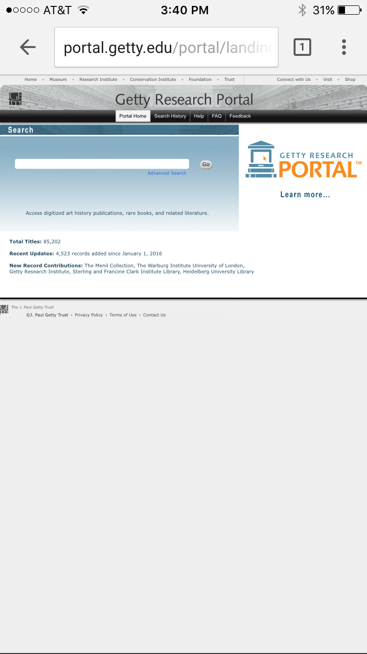

Responsive
Design

Slide 9
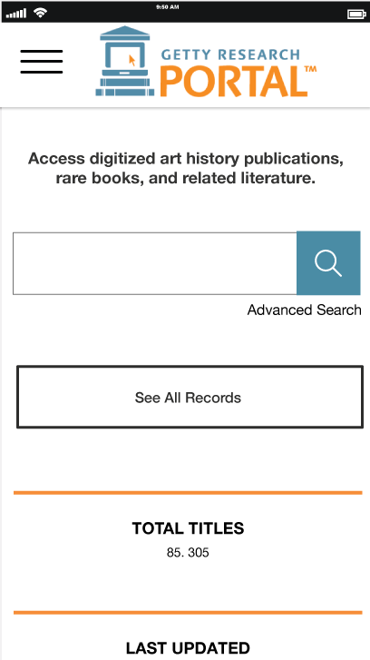
Responsive
Design

Slide 10

What is AngularJS? What is Elasticsearch? Why use them?

Slide 11

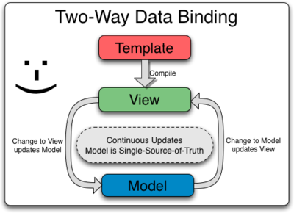
Two way data-binding

Slide 12

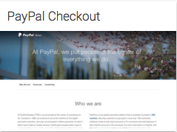
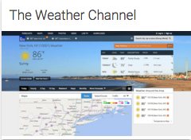

madewithangular.com

Slide 13
ElasticSearch:
How do you use it?
¯\_(ツ)_/¯
Let’s ask Adam!

Slide 14
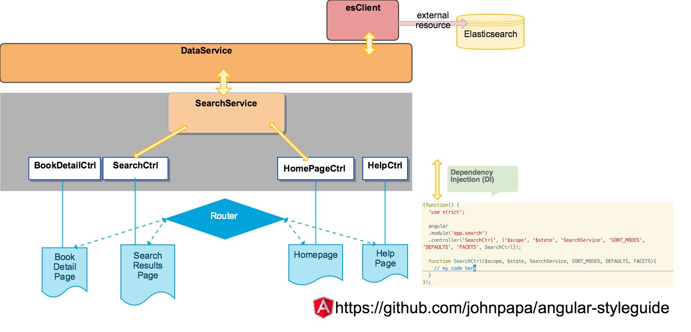

Slide 15
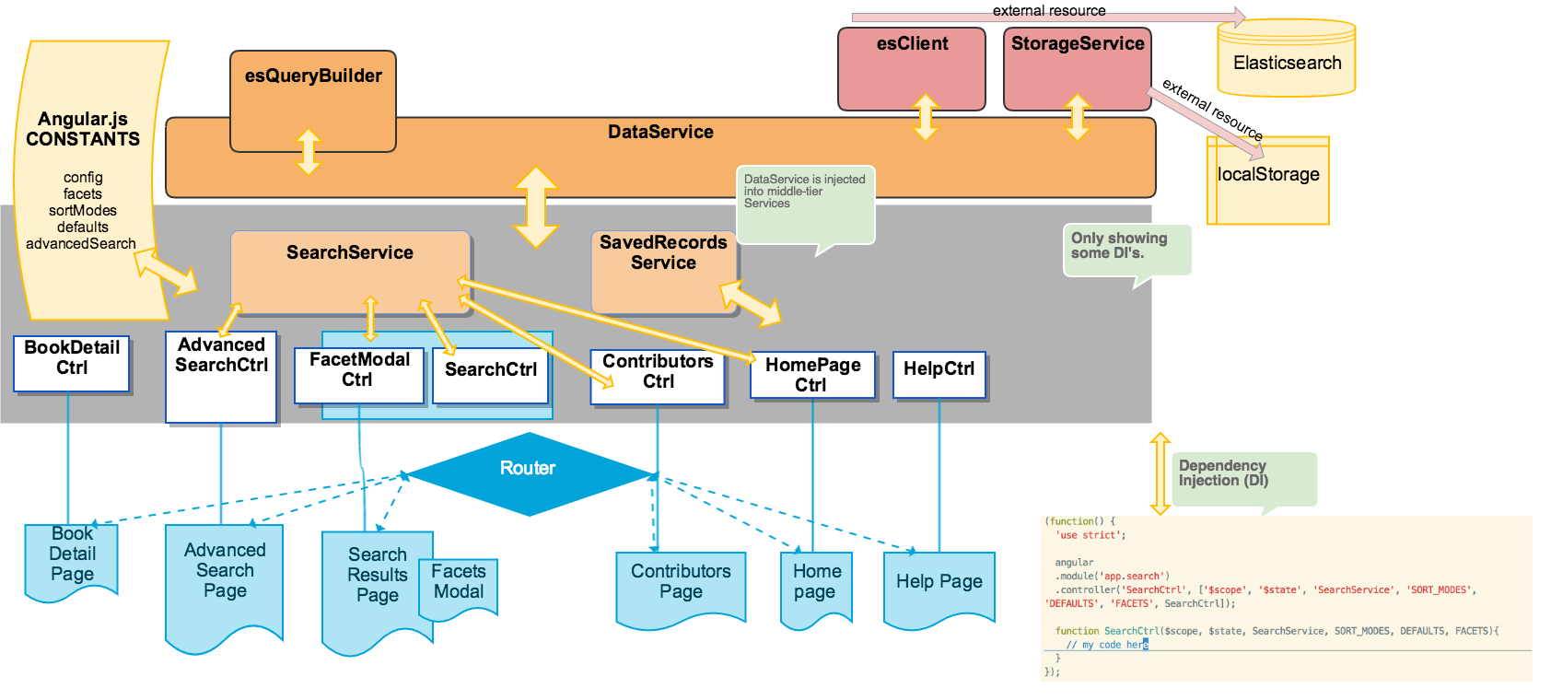

Slide 16
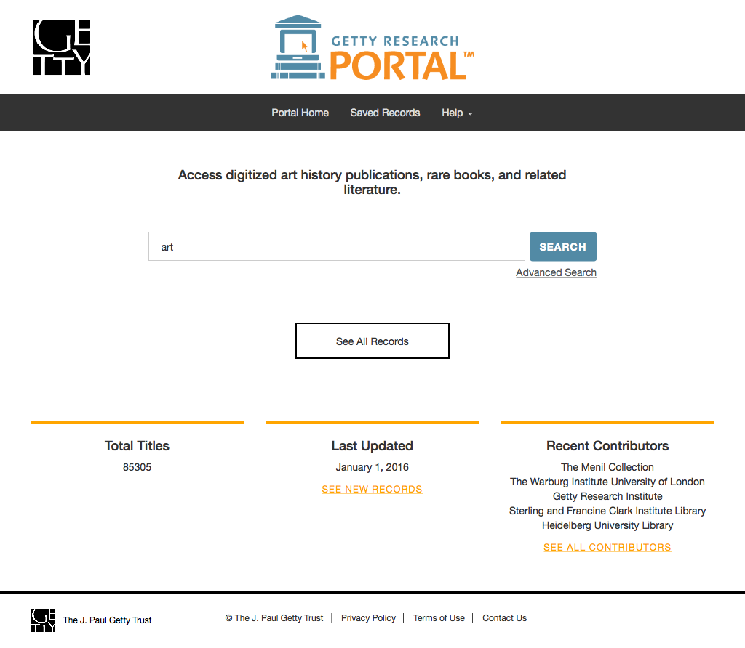

Slide 17
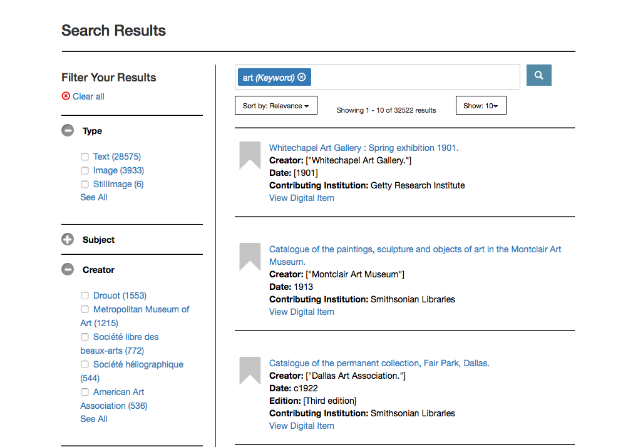

Slide 18
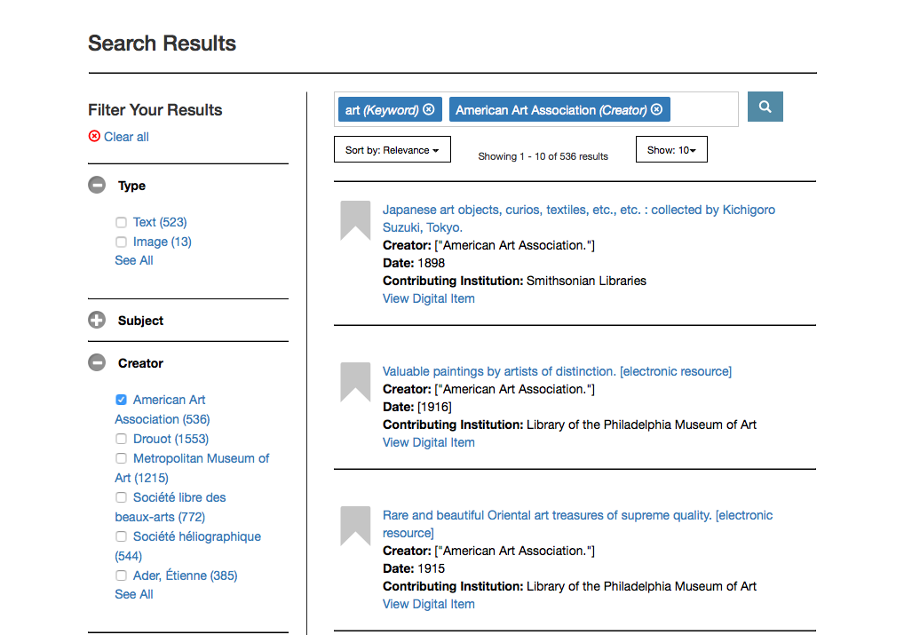

Slide 19
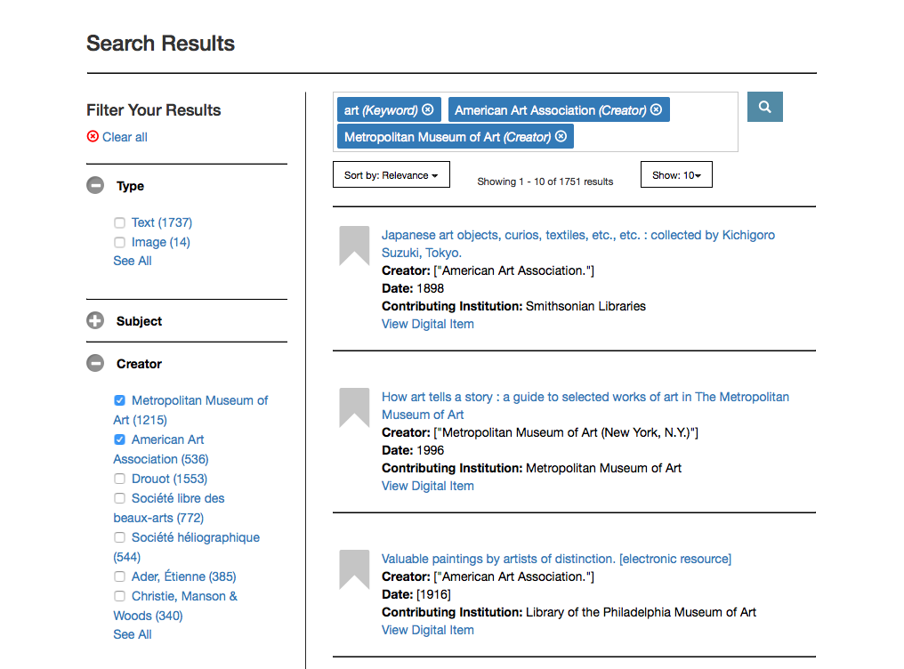

Slide 20
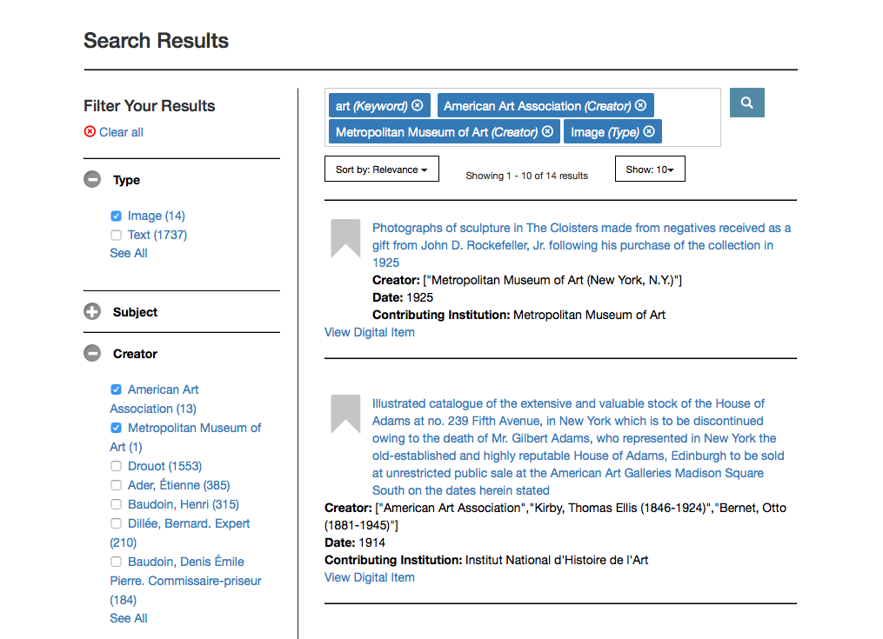

Slide 21
The Team!
Adam Cahan
Kristen Carter
Jenny Franco
Josh Gomez
Susie Ley
Lawrence Olliffe
Alyx Rossetti

Slide 22

Thanks!
Any questions?
You can find us at acahan@getty.edu & @susieley & sley@getty.edu

